Slide 1
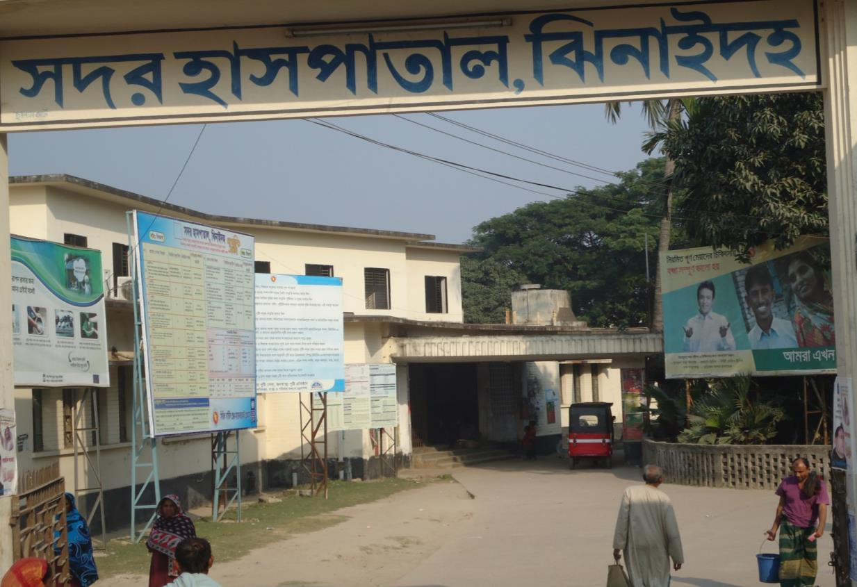
Community Participation in Hospital Service Improvement -
the case of Jhenaidah Sadar Hospital
Dr. Md. Emdadul Haque
Senior Consultant (Obs & Gyne)

Slide 2
Population : 1857149
Pregnant mothers : 38074
Total Live birth : 36465
U5 children : 222120
No. of Upazilla : 06
Paurasava : 06
Union : 67
Govt. Health Institutions : 253
a) Sadar Hospital : 01
b) Upazilla Health Complex : 05
c) H&FWC/ RD (57+13) : 70
d) Community Clinic : 171
e) NTC : 01
f) IHT : 01
g) MCWC : 01
h) MATS : 01
i) Sishu Hospital (25 bed) : 01 (non-functional since 2008)
j) ORS Plant : 01
9. Non-Govt. Health Institution : 116
i) Diabetic Hospital : 01
ii) Eye Hospital : 01
iii) Private Clinic (Regd.) : 114

Slide 3

Sadar Hospital, Jhenaidah
Human Resources
Serial No. | Person | Post | Vacant
01 | Doctor | 40 | 21
02 | Nurse | 48 | 02
03 | MLSS | 10 | 0
04 | Ward boy | 03 | 03
05 | Ayah | 03 | 03
06 | Cleaner | 07+1 | 01
07 | Guard | 03 | 03
08 | Gardener | 01 | 01
09 | Electrician | 01 | 01
10 | Trolley man | 00 | 00
11 | Others
 | Total | 151 | 50

Slide 4
Genesis of the thinking on Community Participation
First got the idea from NIPSOM in 1991 and Foundation course in BPATC in 1992, and tried in the Lohagara UHC as MO-MCH
2. From 1996 to 2012, took initiatives to develop Upazila level standard services in Chowgacha health complex.

  Mobilized 46 additional workers from community (26 volunteer, 12 cleaners and others 8).
  EOC Beds increased from 11 to 41
  Chowgacha UHC became the best EOC center with 98.4% delivery rate
  Chowgacha UHC achieved MDG target in 2009.
From May 2012, we are working in Jhenaidah Sadar Hospital to develop a model district hospital
  In 2015, hospital delivery is highest among the 100 bedded hospitals
  Received award for TQM activities.

Slide 5
Jhenaidah Sadar Hospital –
initial challenges in 2012
Shortage of manpower,specially 4th class staff
Inadequate services especially EOC and pediatric service.
Dire problem in cleanliness.
Inadequate coordination with local administration and community leaders
Poor documentation and reporting system.
Demoralized and insecure environment.

Slide 6
Stepwise Initiatives to address the challenges
Prepare a hospital survey report in June 2012 and compared the progress with the baseline report of 1998.
Meeting with Service providers, Administration, local leaders and civil society
Community motivation and social mobilization
Reform of EOC program and involvement of community participation
District health improvement committee reactivated.
Regular monthly meeting, formation and functioning of WIT & QIT.
Improved cleanliness and beautification of the hospital.
Communication with MOHFW, DGHS, JICA, BPATC, ICDDRB.
Improved financial management.
Reform of pediatric word.
Celebrate a big cleaning day.

Slide 7
Jhenaidah Sadar Hospital, Jhenaidah
Achievement of the Hospital
1. Active Community Participation
MP, Mayor, local industrialists, doctors, community members provide honarium for 57 non-govt. hospital workers. (Cleaner 20, Ayah & ward boy 23, Guard 6, Volunteer 5, Trolley man 3) .
2. Improve Performance of Obstetric Program
1. Highest number of NVD and 2nd highest in total deliveries in Khulna division.
2. Instituted ANC, PNC and breastfeeding, MR & PAC service corner.
3. Improved Cleanliness and Beautification of Campus.
4. Improved Pediatric Service.
6. Improved Security.
7. Improved Financial Management
Highest revenue generation in Khulna Division (from Tk74,67,682 in 2013 to Tk 91,79,279 in 2014).

Slide 8
Community Support in Sadar Hospital
MP of Jhenaidah-2 providing 14 manpower support.
Doctors of the hospital and Jhenaidah town supports 18 man power.
Mayor plays an important role in cleanliness, repaired the boundary wall, made 4 dustbins and supports 3 man power.
Bigger role in ensuring security and wastage management
A retired Secretary donated a generator for 24 hours OT service with a cost of nearly 33 thousand taka.
Chairman of Zahedee foundation supports 10 manpower and an intercom at a cost of nearly two lac taka.
Many other small local supports

Slide 9

Sadar Hospital, Jhenaidah
Bed Occupancy Rate from 1998 to 2014
Sl. No | Year | Bed Occupancy Rate
01 | 1998 | 126%
02 | 2011 | 146%
03 | 2013 | 165%
04 | 2014 | 180%

Slide 10

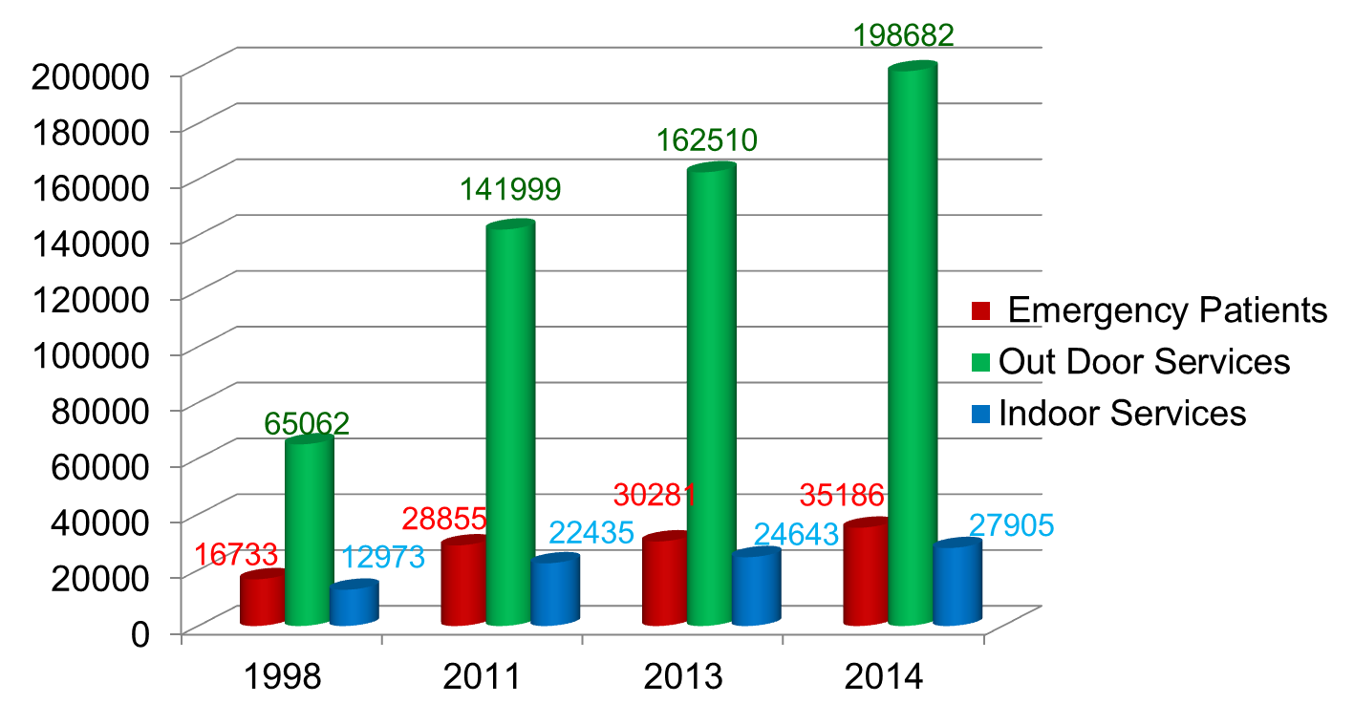
Emergency, Out Door & Indoor Service 1998 to 2014
Sadar Hospital, Jhenaidah

Slide 11
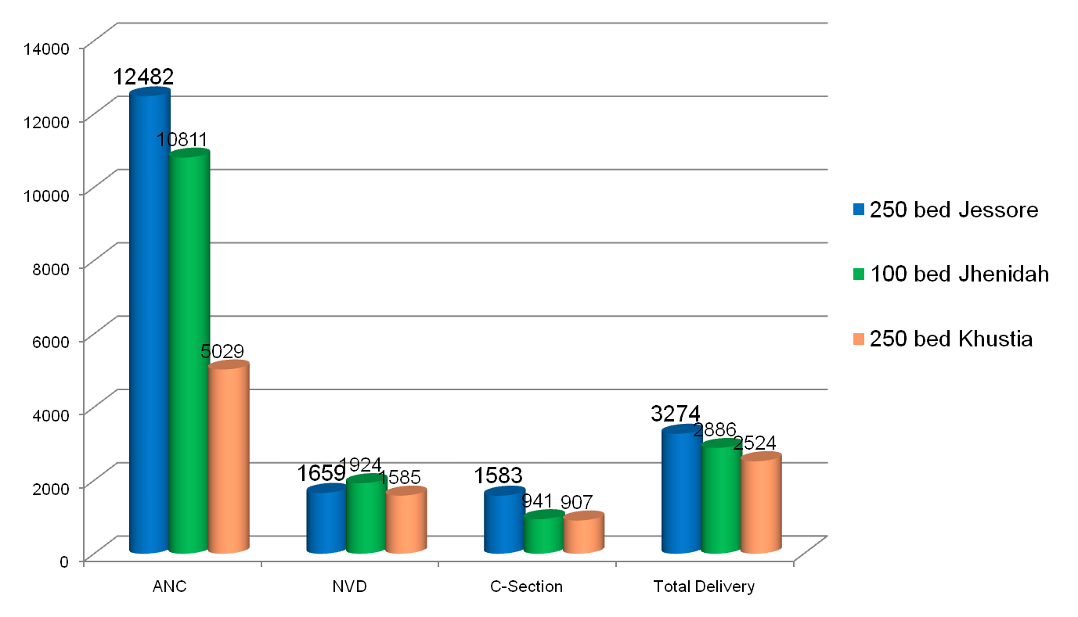
Comparative Data of EOC Service of 3 Best Performing District Hospital of Khulna Division in 2014

Slide 12

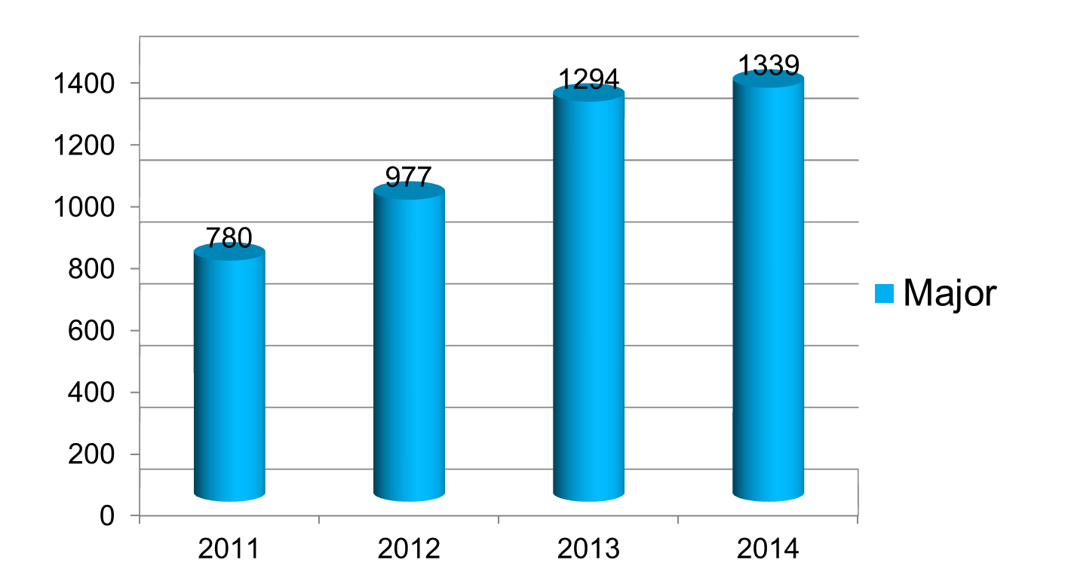
Operation Service (Major) 2011 to 2014
Sadar Hospital, Jhenaidah

Slide 13
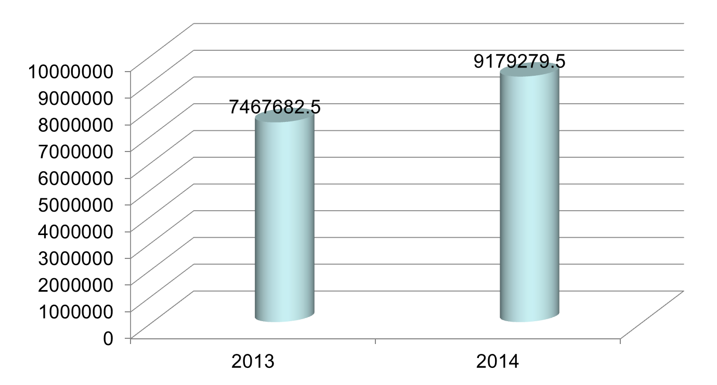
Comparative data of revenue income in Jhenaidah district in 2013 & 2014
Sadar Hospital, Jhenaidah

Slide 14
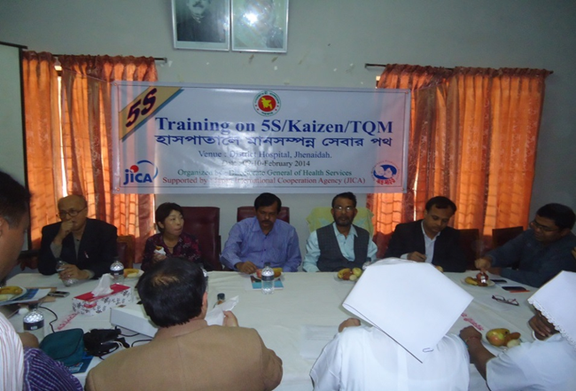
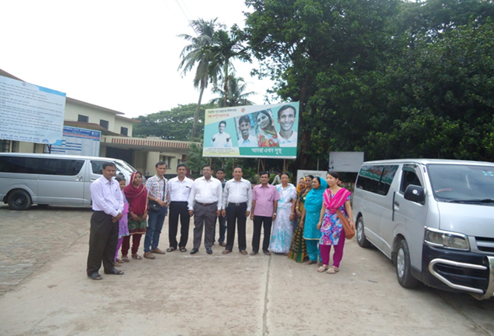
Introduction of TQM activities and Visit to Shatkhira District Hospital
  In 9 February, 2014, 5S-CQI -TQM program started by DGHS & SMPP JICA. Staff orientation on 5S-CQI-TQM process.
  5th August, 2014 an Idea sharing visit of 15 team members headed by civil surgeon at Shatkhira District Hospital with the help of JICA.

Slide 15
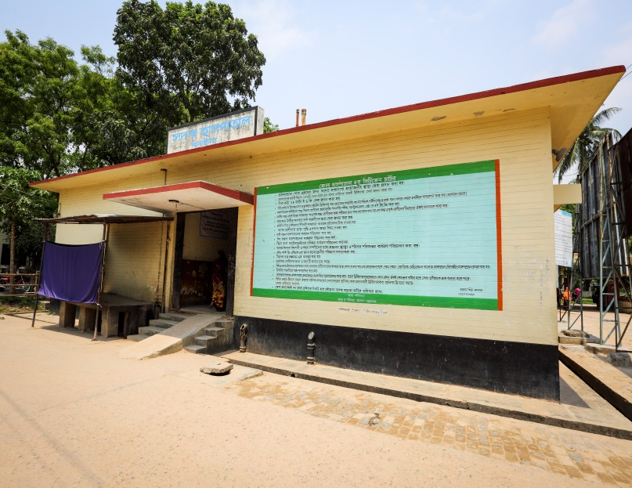
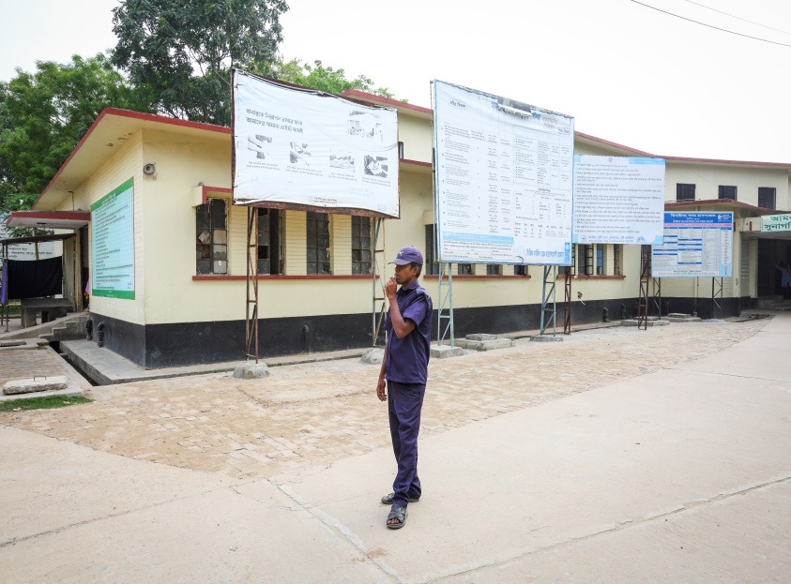
Display of citizens’ charter of Sadar Hospital.
Community supported guard is removing cycle, van and easy bike from the campus.

Slide 16
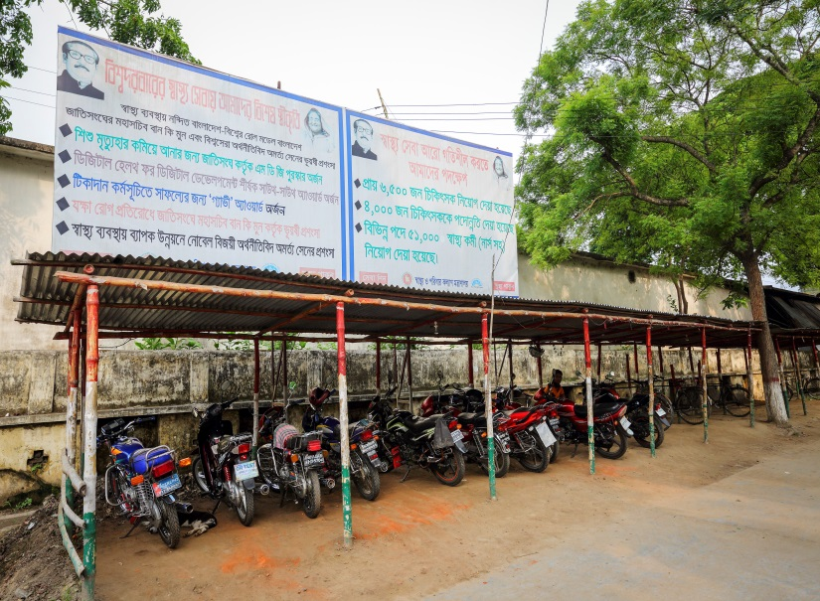
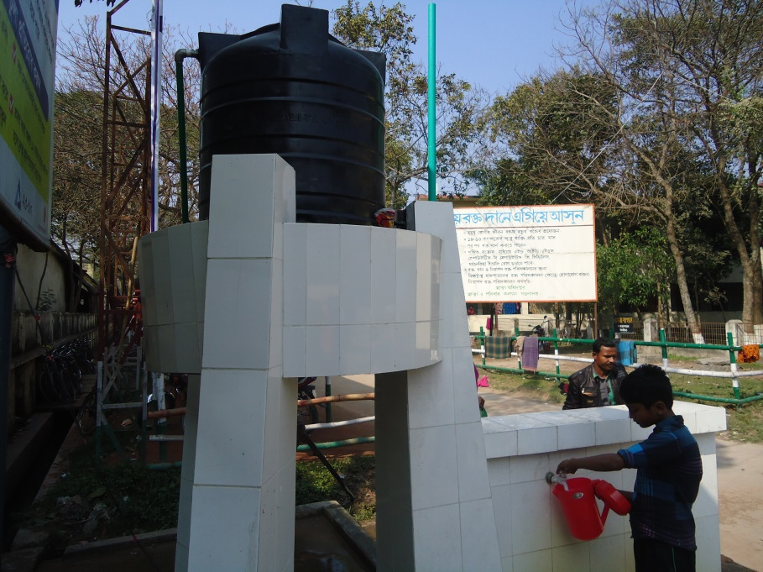
Cycle Stand
To secure the cycle and motor cycle of the patients and their attendants.
Safe drinking water supply for the patients and their attendants.

Slide 17
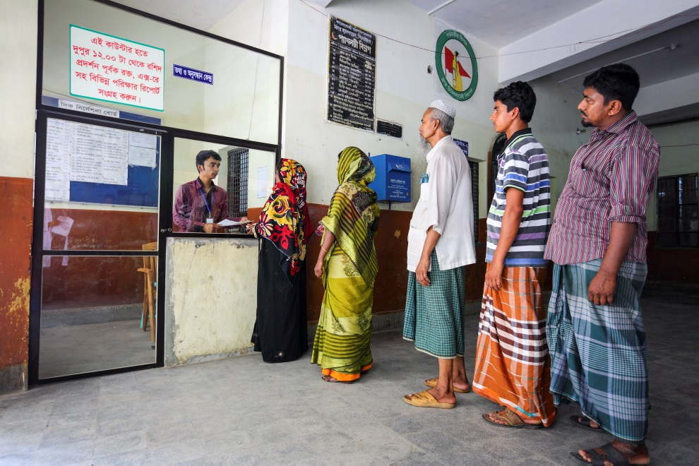
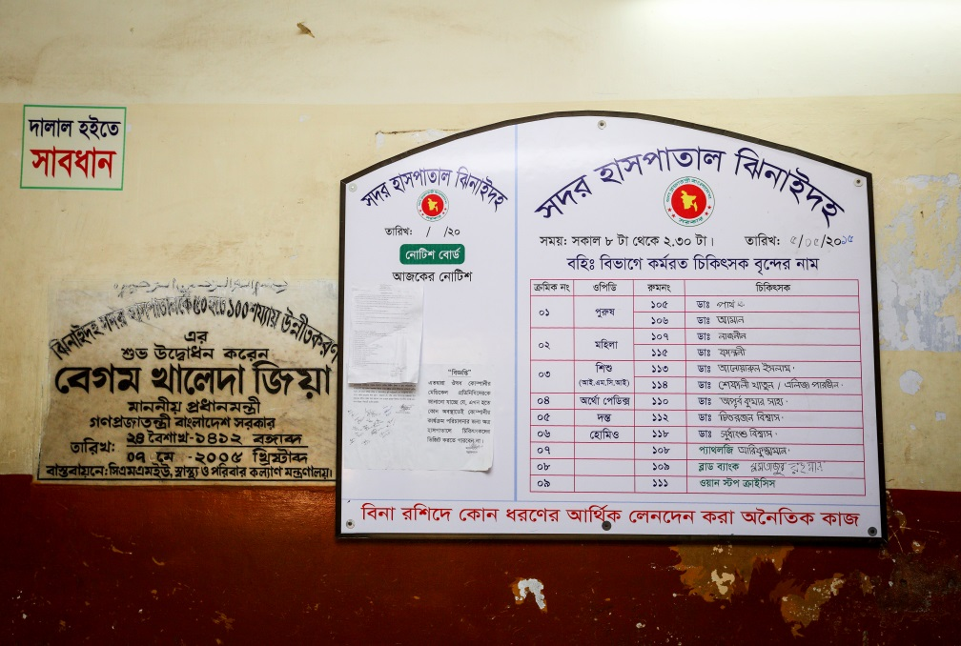
Hospital reception and information center for the patient and their attendance are developed by the community support system.
Display of the duty roaster of outdoor doctors.

Slide 18
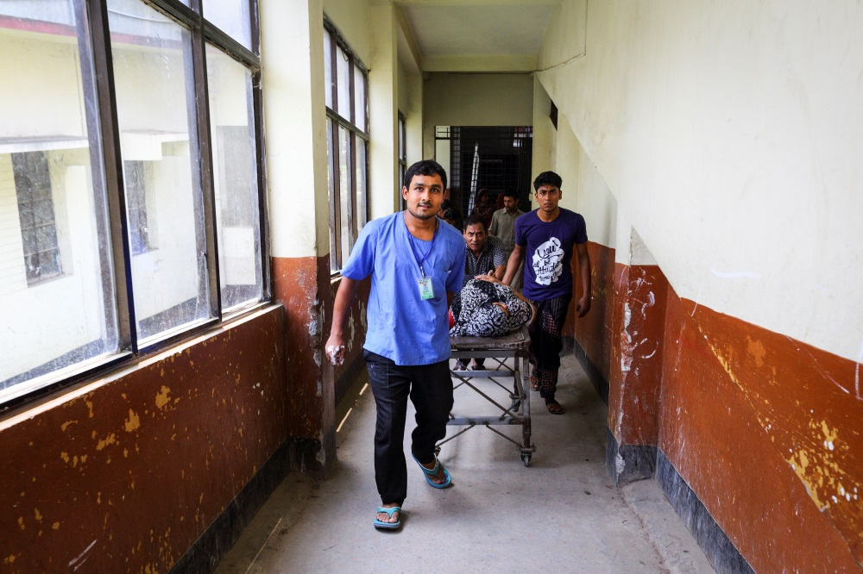
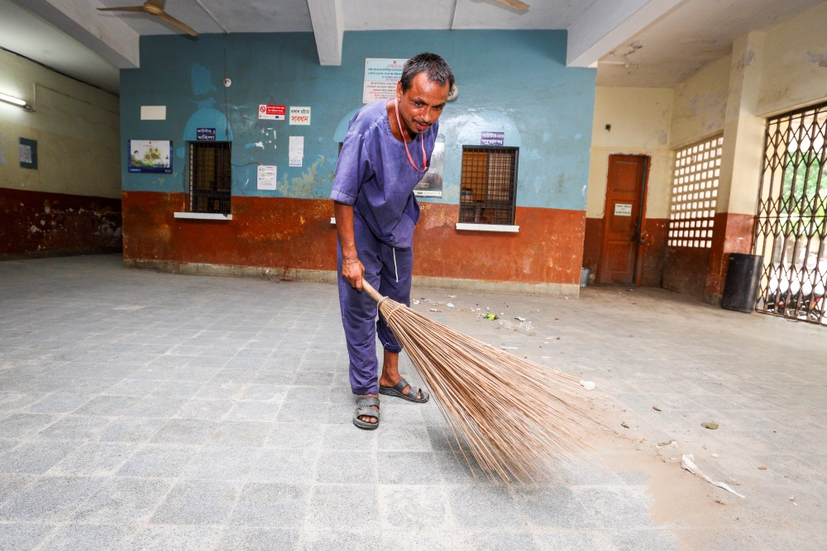
Community supported trolley man is carrying a patient.
Community supported cleaner is cleaning the hospital.

Slide 19
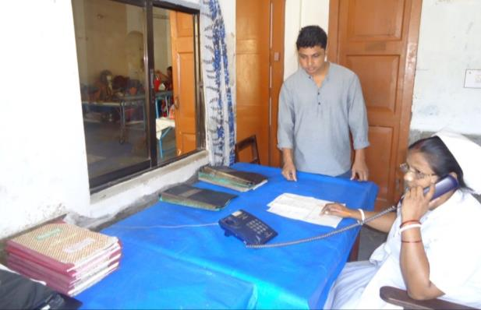
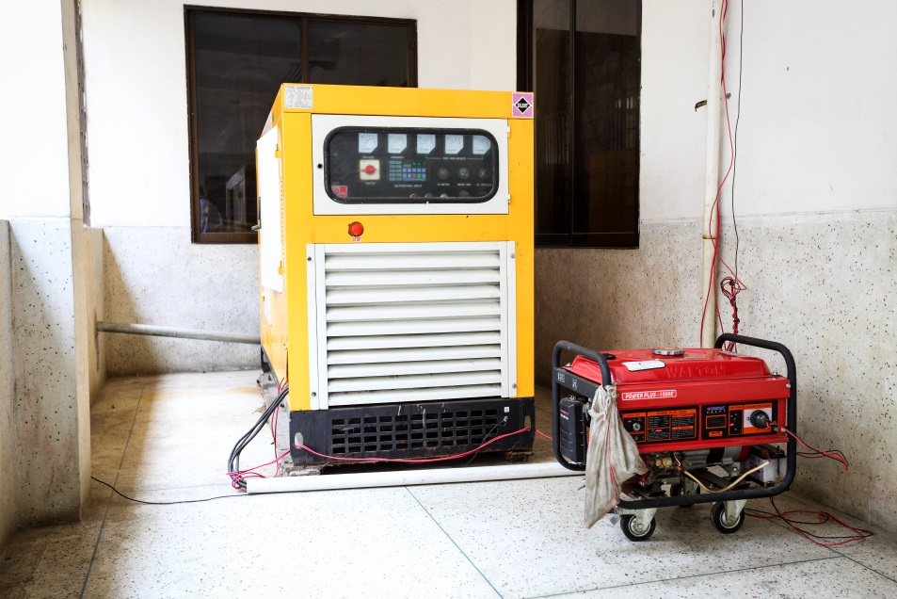
To facilitate easier communication among the hospital staff an intercom is donated by an honorable local industrialist and thus the efficiency of the service has been improved
A non-operating government generator is activated and a new generator is supplied by the community to ensure electric facility.

Slide 20
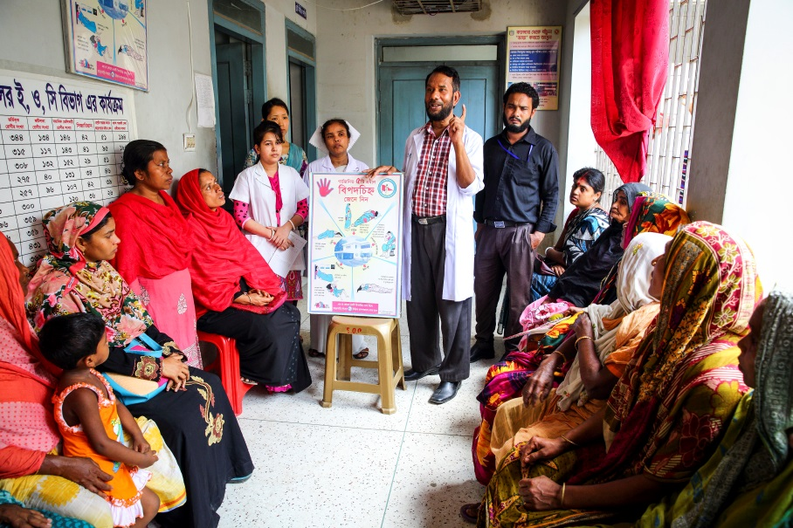
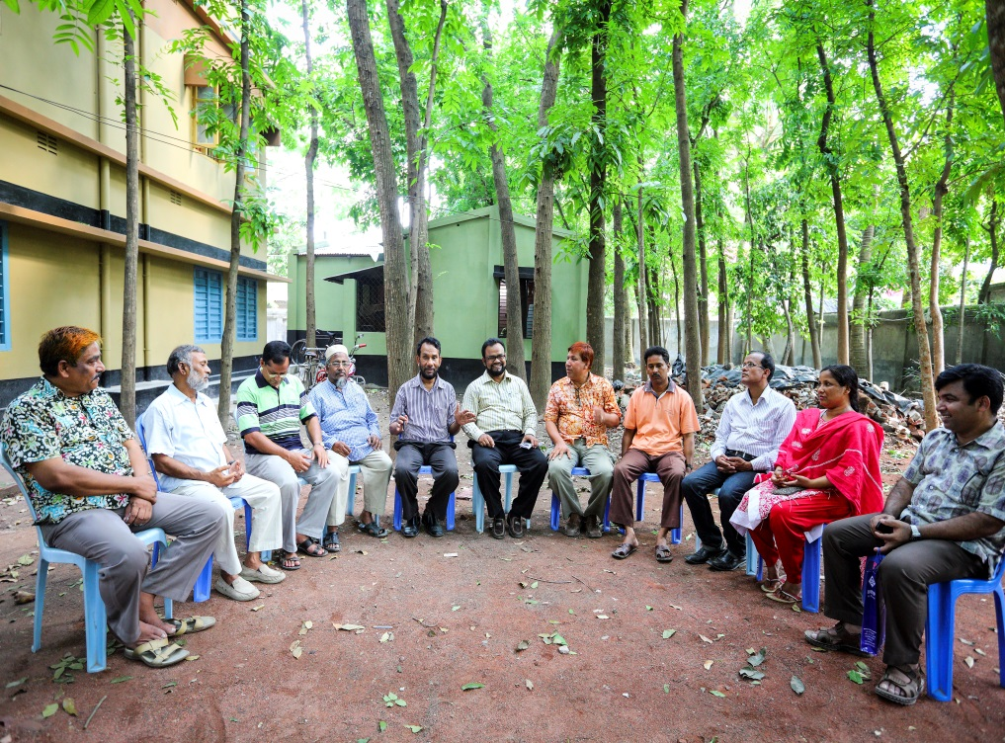
Creation of awareness by Health Education for the patients and their attendances.
Motivation of the community, the teachers, reporters, social workers, cultural activists and donors of the hospital .

Slide 21
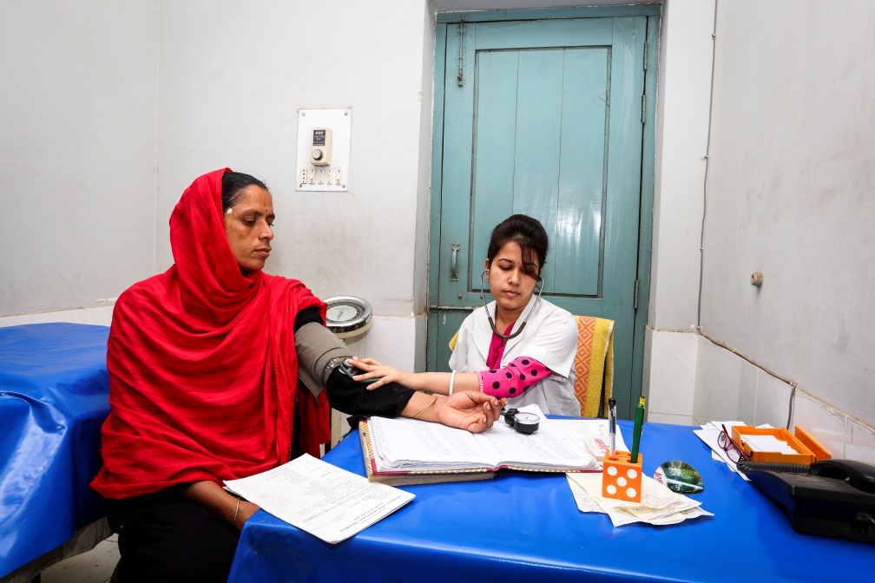
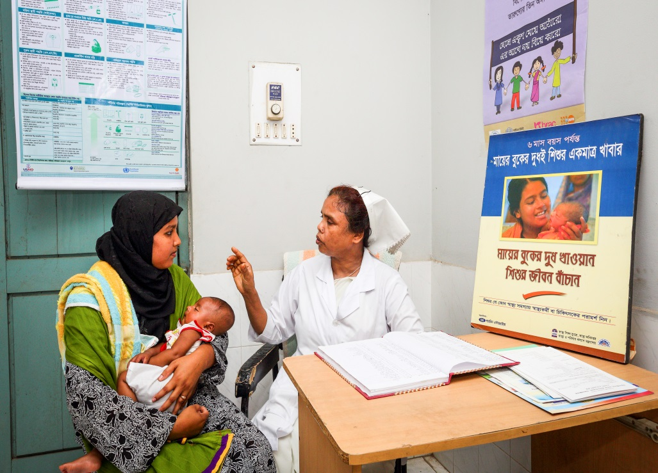
Antenatal and postnatal care of pregnant mother in antenatal corner of EOC word.
Breast feeding and family planning corner of EOC word.

Slide 22
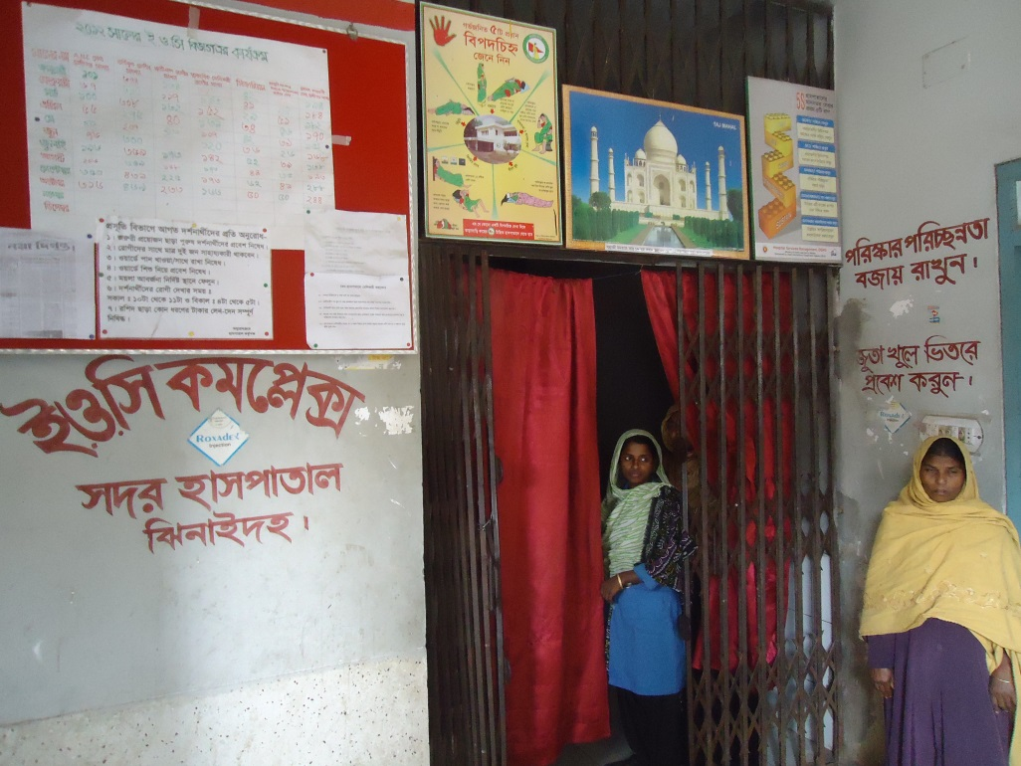
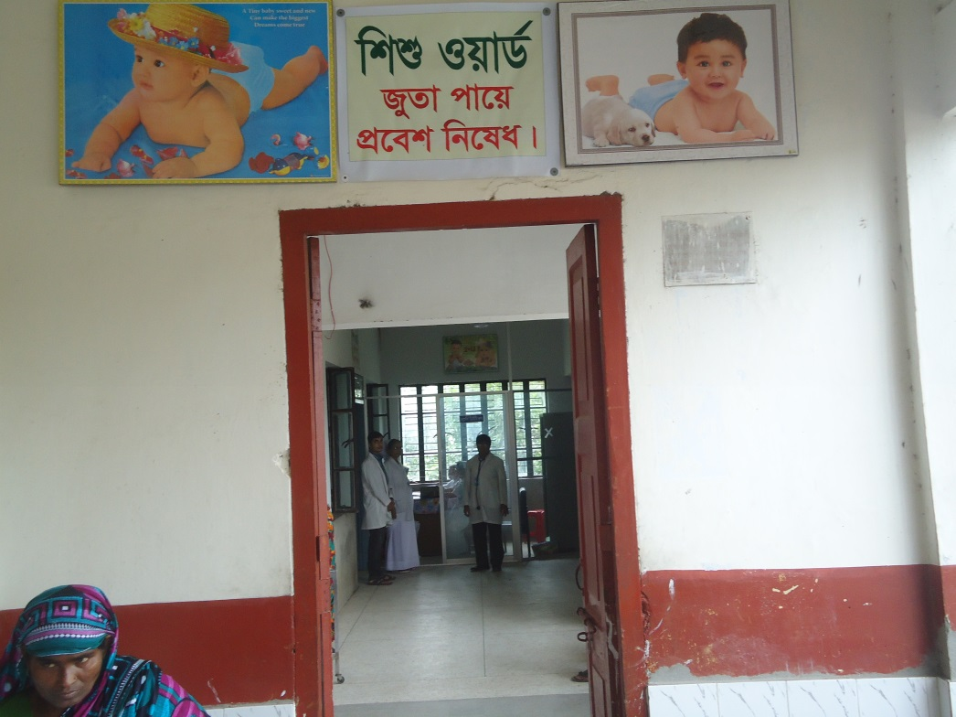
Improved EOC (Emergency Obstetric Care) word service.
Improved pediatric word.

Slide 23
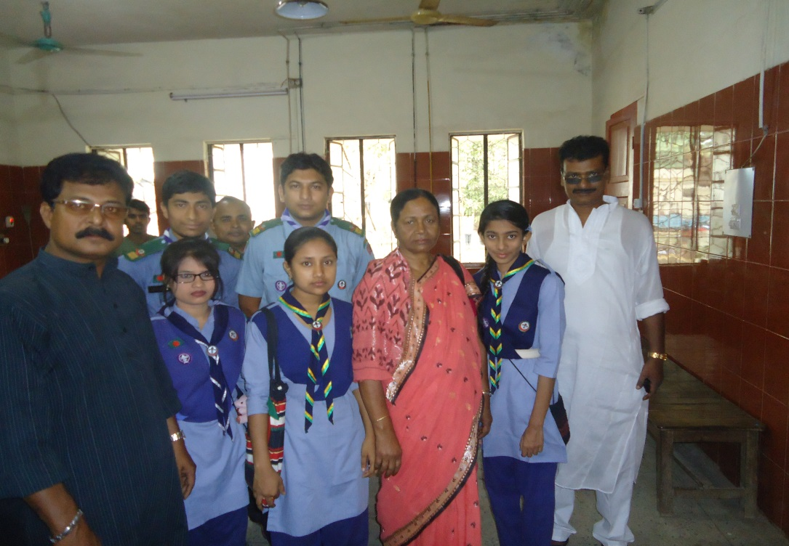
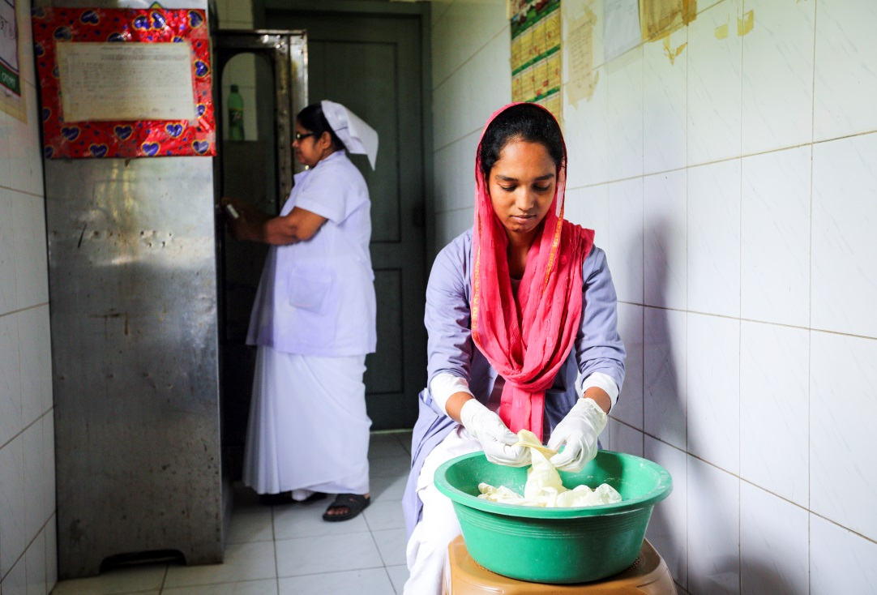
Girls’ Guide are working in the outdoor for lining of the patients to take proper service.
College going poor students are working in the hospital as nursing assistant (Volunteer).

Slide 24
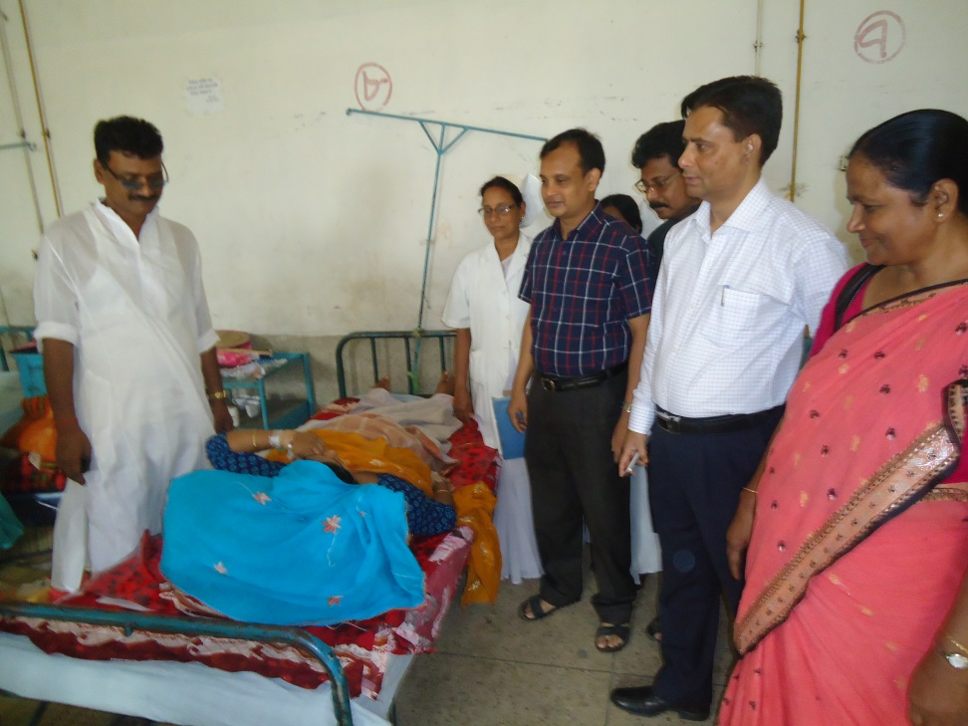
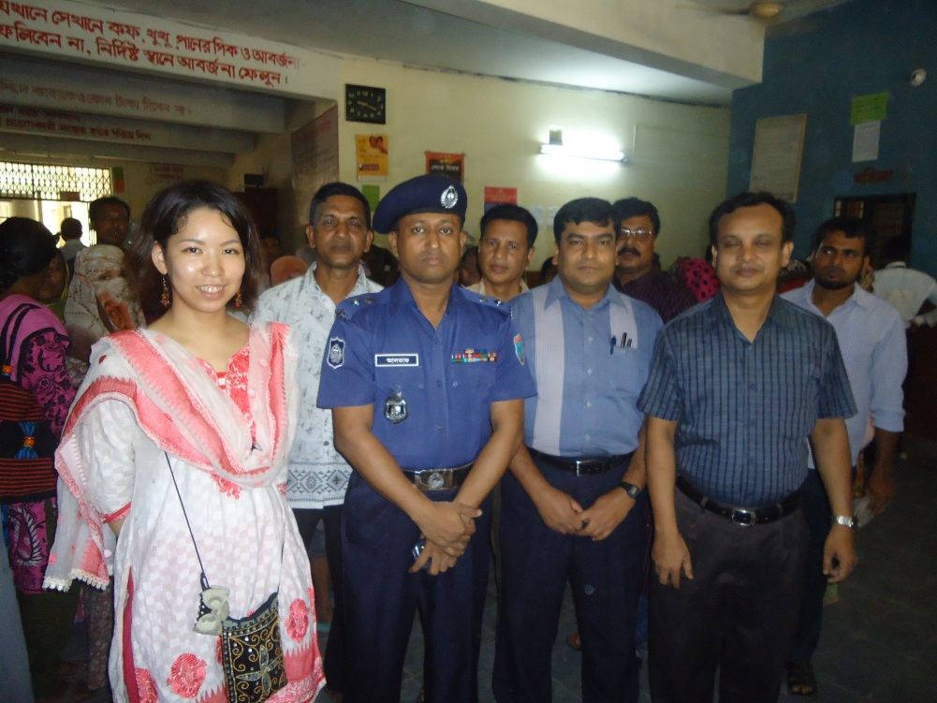
Deputy Commissioner (DC), Jhenaidah visited the Sadar Hospital to observe the Hospital activities.
Superintendent of Police (SP), Jhenaidah visited the Sadar Hospital to observe the Hospital activities and to ensure security of the hospital.

Slide 25
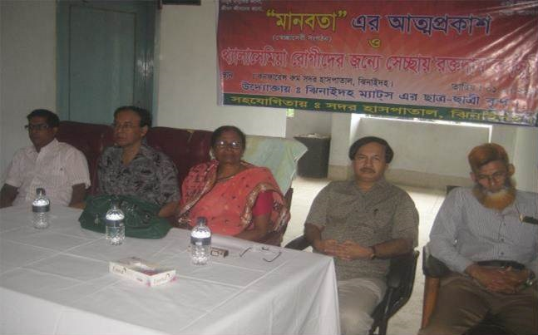
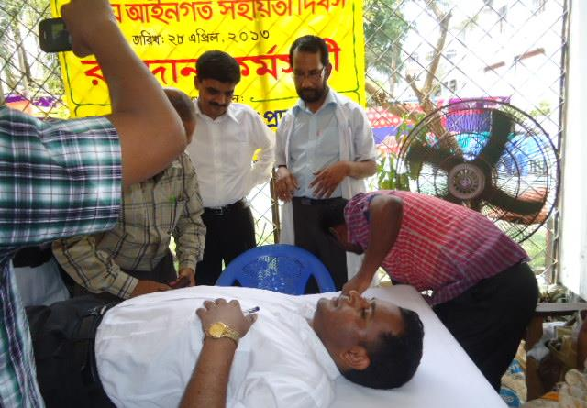
MANOBOTA- a volunteer blood donor organization has formed by the doctors and SACMOs to donate blood for the thalasemic and other patient of the hospital.
A blood donation camp arranged by District Judge of Jhenaidah with the help of MANOBOTA.

Slide 26
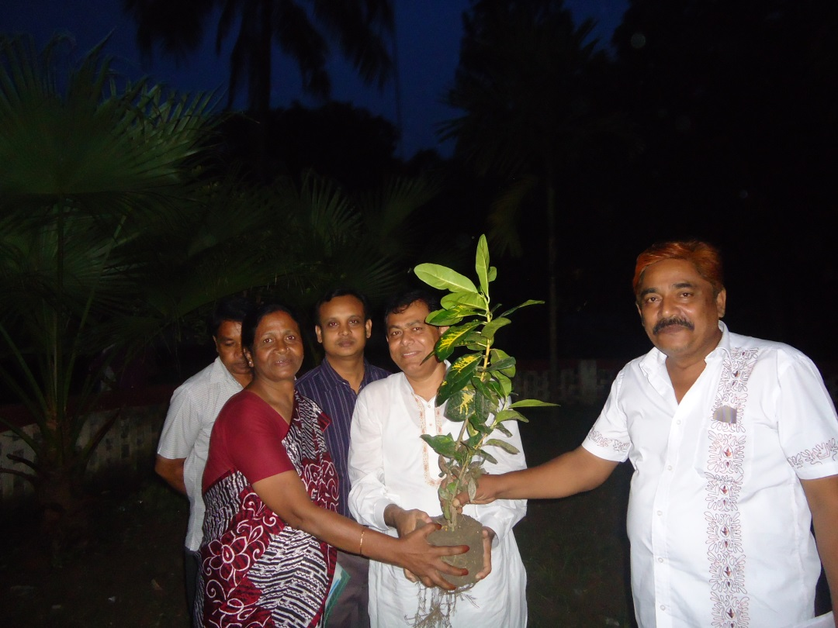
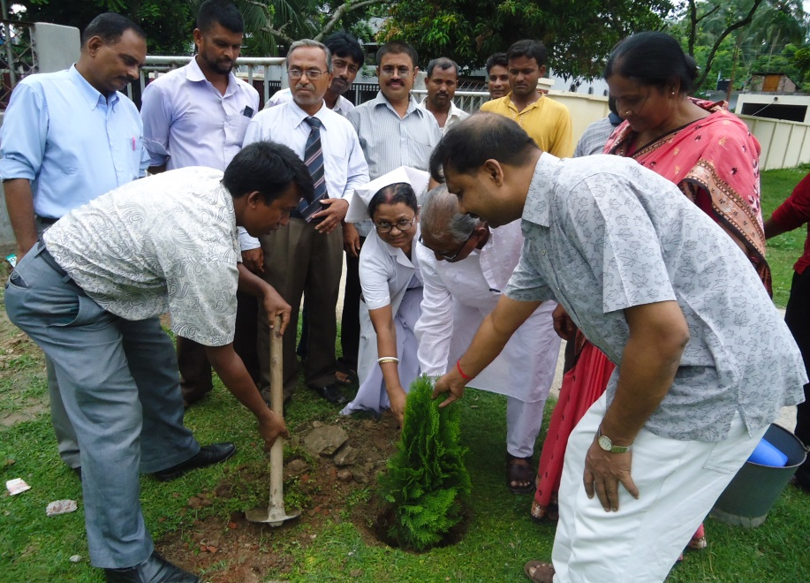
Hospital campus beautification started by previous MP of Jhenaidah-2.
Beautification plant is planted by Zilla Praised Administrator and Upazilla Praised Chairman.

Slide 27
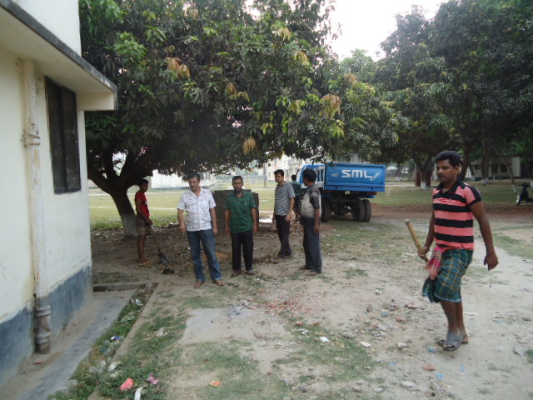
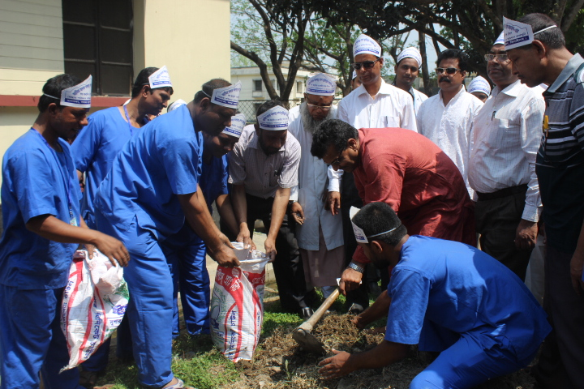
Hospital garbage is removed regularly by the Paurasava.
17th,March “a big cleaning day” is being celebrated to clean the hospital by DC, Mayor, Civil Surgeon & staffs of the hospital , under the leadership of Superintendent.

Slide 28
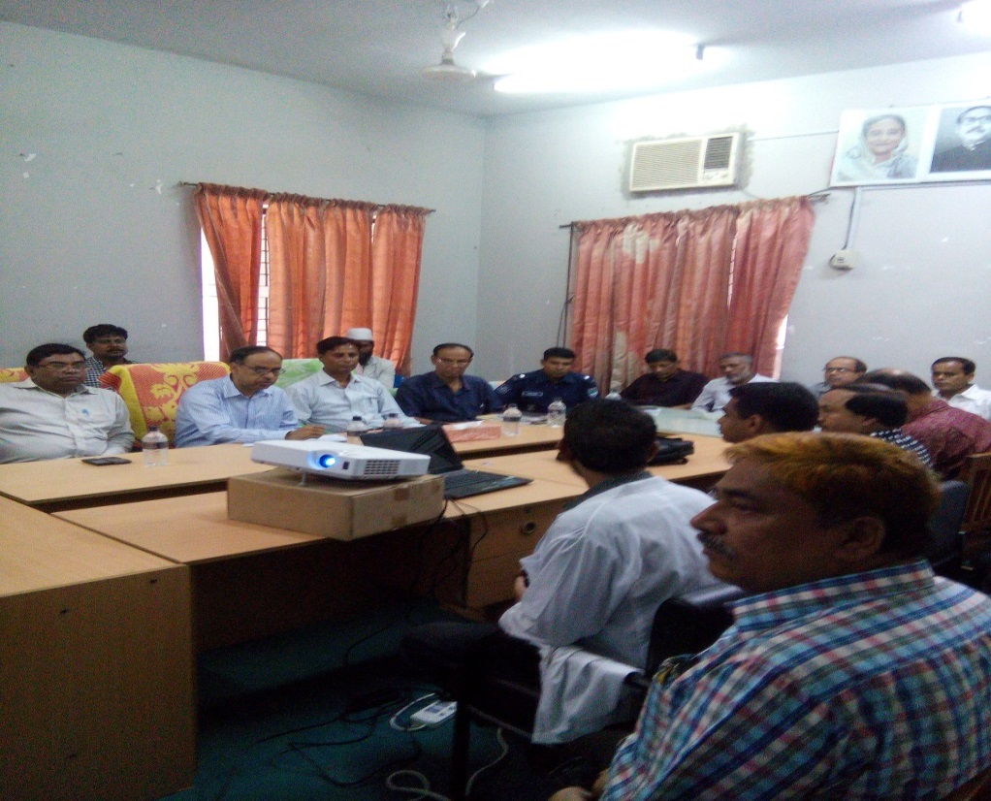
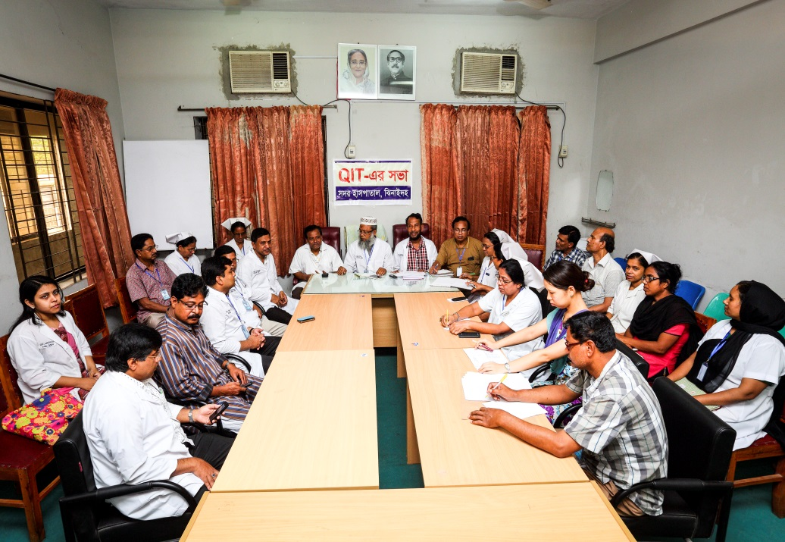
Meeting of the stakeholders with the stakeholders and donors of Jhenaidah Sadar Hospital with additional secretary (health) Md. Asadul Islam.
Meeting of QIT (Quality Improvement Team) is held in the conference of Jhenaidah Sadar Hospital.

Slide 29
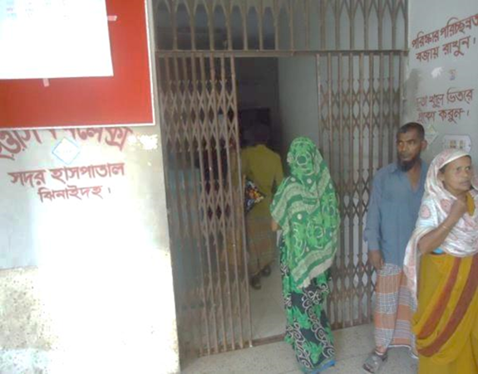
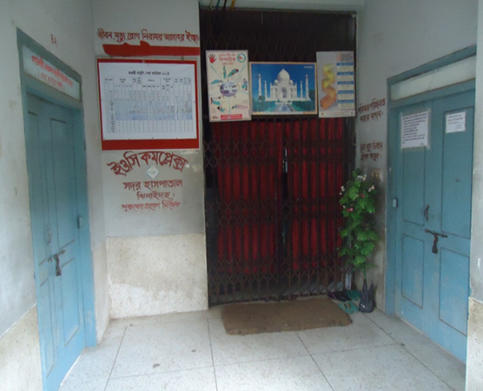
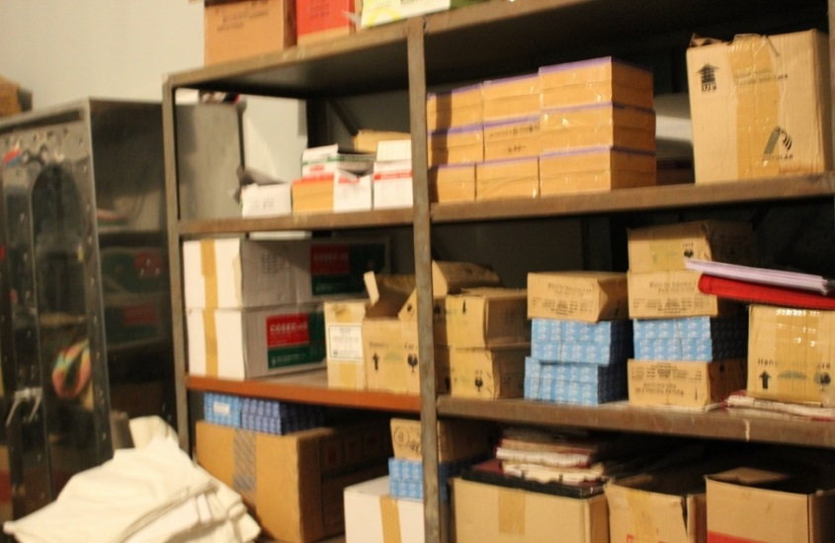
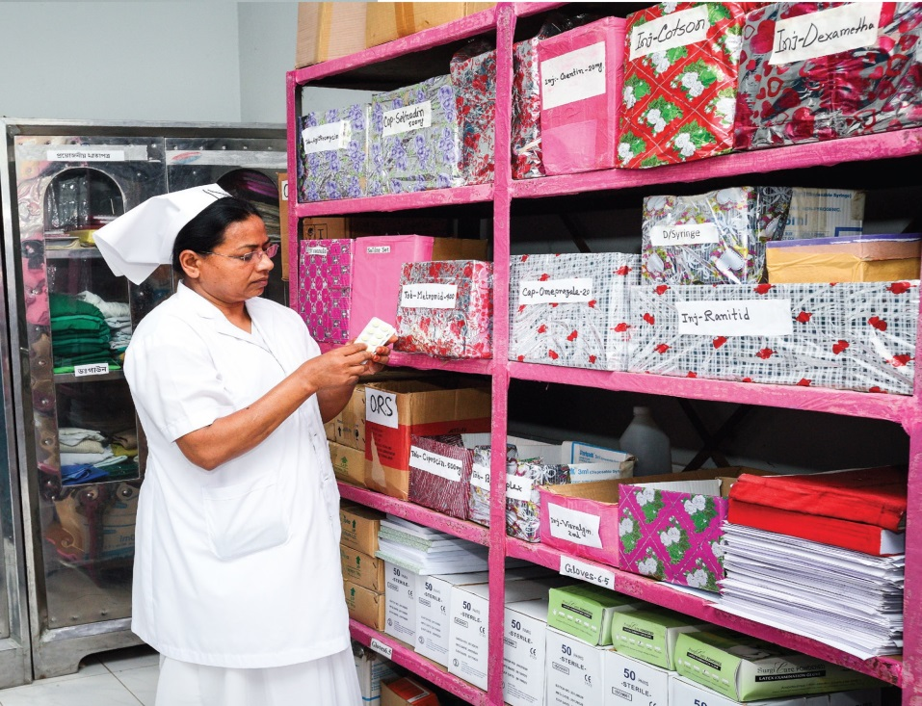
Changes in EOC Ward
Before
After
Before
After
Before
After

Slide 30


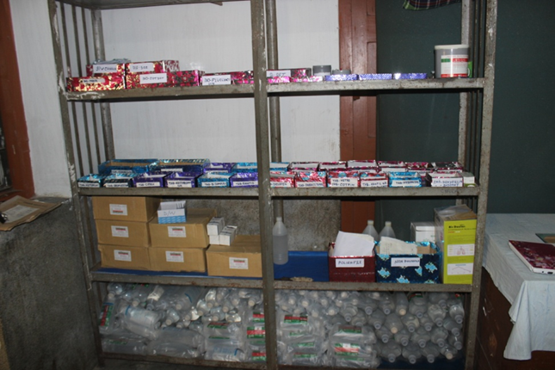
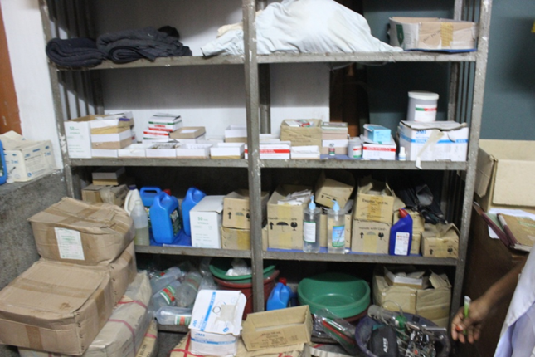

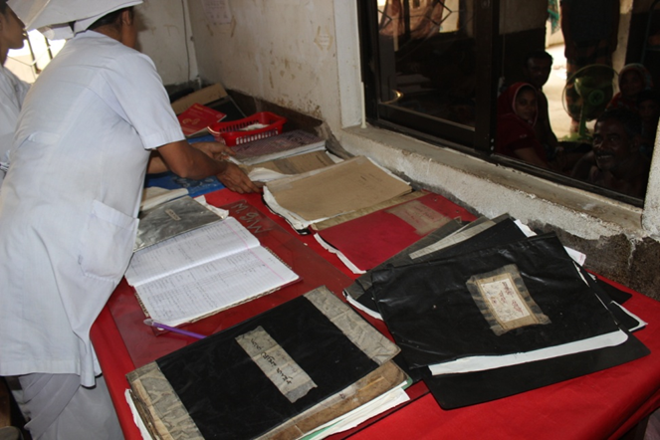
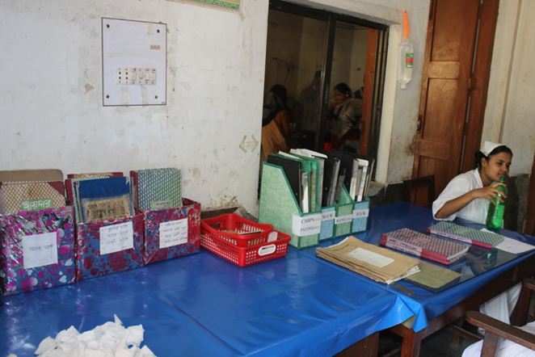

Changes in Surgery Ward

Slide 31
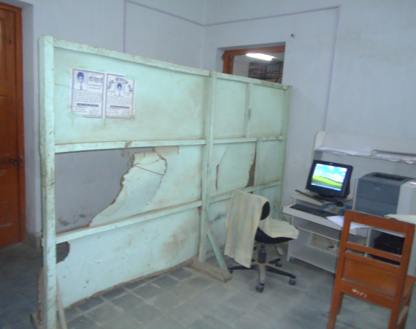
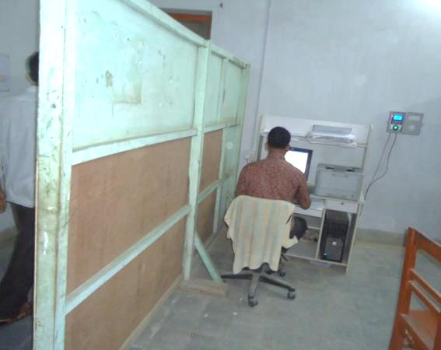
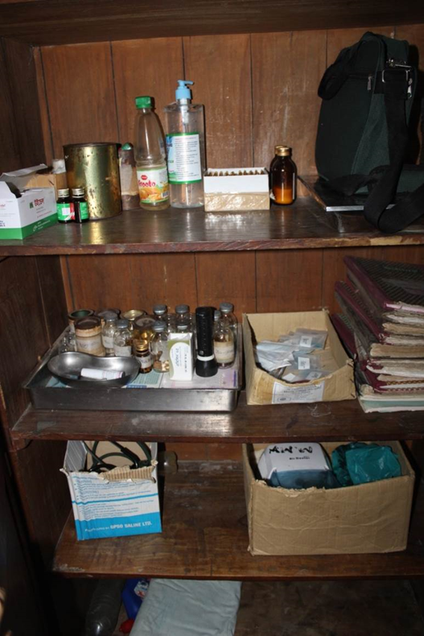
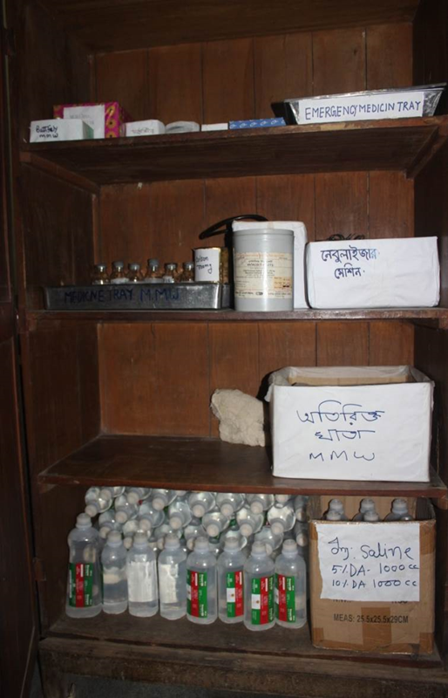
Changes in Office & Medicine Ward
Before
After
Before
After

Slide 32
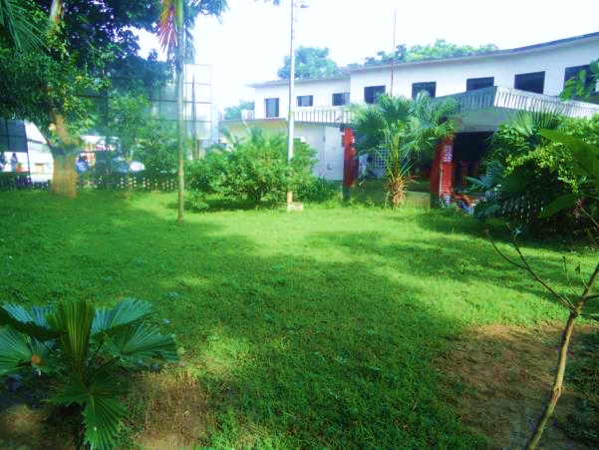
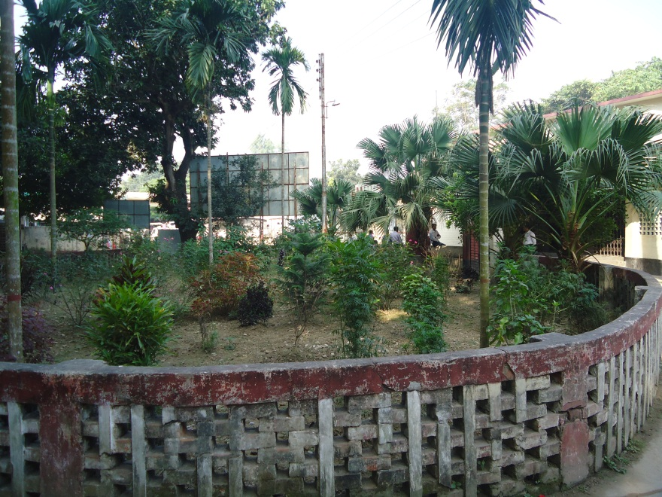
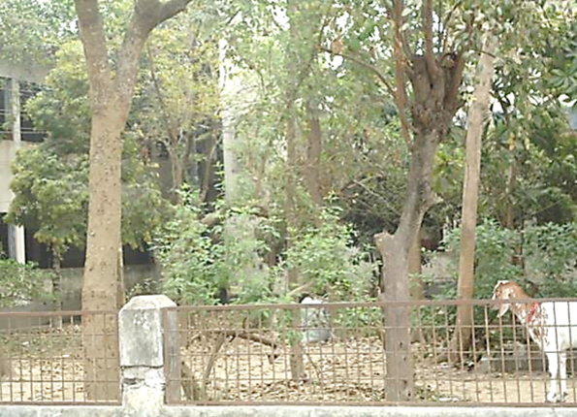

Changes in Gardens of The Hospital
Before
After
Before
After

Slide 33




West Management & Campus Protection
Before
After
Before
After

Slide 34




Hospital Environment

Slide 35

Lessons learned
Public health and hospital services and resources are inadequate vis-à-vis the need specially for the poor
This gap can be minimized through local participation.
Effective health service and hospital management require local support and participation.
Health personnel, specially the local health manager should take the role of catalyst
Local support can be attracted through improved services, and visible efforts and morality of the health managers
MOHFW can take initiative to roll out the model and the message
Jhenaidah-Chowgacha team will happy to volunteer

Slide 36
Immediate support required
All vacant post of doctors and nurses to be filled up.
Hospital contingencies need increase (from Tk 10000/-)
Ambulances to be replaced.
Manpower for NTC, MATS, IHT, ORS Plant, Sishu Hospital should be solved – Dist hospital should not bear the burden.
Improved X-Ray, Ultrasono and Pathological instruments.
Renovation and reconstruction of the hospital building is necessary.
The construction of 250 bedded hospital can be started.

Slide 37


